Slide 1
UNIT - I
Measures of Dispersion

Slide 2
CONTENT
Range
Quartile Deviation
Mean Deviation
Standard Deviation
Coefficient of Variation (C.V.)
Basic concept of Skewness
Kurtosis

Slide 3
Definition
An average can represent a data-set only as best as a single value can, but it certainly can not reveal the entire story of the data-set. For example:
5,5,5,5,5; (mean=5, median = 5)
3,4,5,6,7; (mean=5, median = 5)
1,3,5,7,9; (mean=5, median = 5)
In all three data-set above, the average values (mean and median) are the same but we see that an average fails to give any idea about the spread or scatteredness of the observations in the data-set. This scatteredness is also called dispersion. Some important measures of dispersion are range, mean deviation and standard deviation.

Slide 4
According to Dr. Bowley, “Dispersion is the measure of the variation of the items.”
According to Spiegel, “The degree to which numerical data tend to spread about an average value is called the variation or dispersion of the data. ”

Slide 5
Objectives of Measurement of Dispersion
To know the variation of different values of the items from the average value of a series.
To know about the composition of a series or the dispersal of values on either sides of the central tendency.
To know the range of values.
To compare the disparity between two or more series in order to find out the degree of the variation.
To know whether the central tendency truly represents the series or not.

Slide 6
Absolute and Relative Measures of Dispersion
There are two measures of dispersion:
Absolute Measure: When dispersion of the series is expressed in terms of the original unit of the series, it is called absolute measure of dispersion.
Relative Measure: The relative measure of dispersion expresses the variability of data in terms of some relative value or percentage. It is also known as Coefficient of Dispersion.

Slide 7
Methods of Measuring Dispersion
Following are the methods of absolute and relative measures of dispersion:
 | Absolute Measure | Relative Measure
Measures based on Spread of Values | Range (2) Quartile Deviation; Inter Quartile Range | Coefficient of Range Coefficient of Quartile Deviation
Measures of Dispersion from Average | (3) Mean Deviation (4) Standard Deviation | Coefficient of Mean Deviation Coefficient of Standard Deviation, Coefficient of Variation

Slide 8
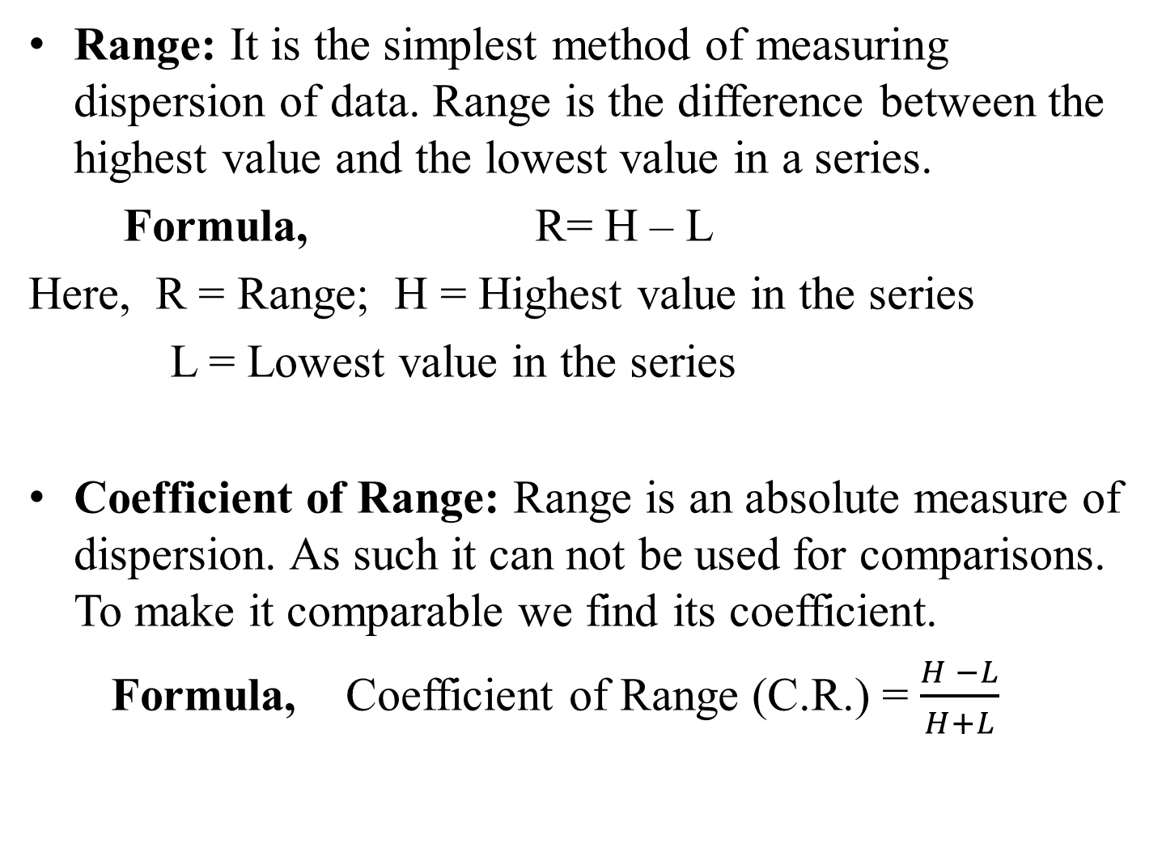
Range: It is the simplest method of measuring dispersion of data. Range is the difference between the highest value and the lowest value in a series.
Formula, R= H – L
Here, R = Range; H = Highest value in the series
L = Lowest value in the series
Coefficient of Range: Range is an absolute measure of dispersion. As such it can not be used for comparisons. To make it comparable we find its coefficient.
Formula, Coefficient of Range (C.R.) = $\frac{H −L}{H+L}$

Slide 9
Merits and Demerits of Range
Merits
Simple
Widely used
Demerits
Unstable
Not Based on all values
No knowledge of the formation of the series
Irrelevant for Open-ended frequency Distribution

Slide 10
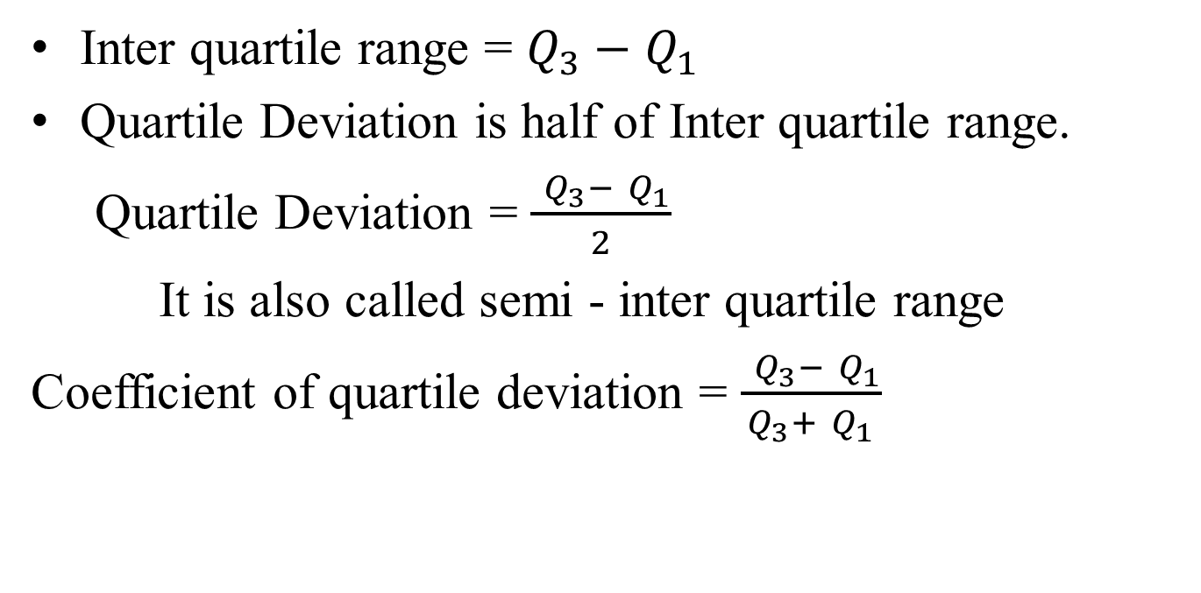
Quartile Deviation
Inter quartile range = $Q_{3}−$ $Q_{1}$
Quartile Deviation is half of Inter quartile range.
Quartile Deviation = $\frac{ Q_{3}− Q_{1}}{2}$
It is also called semi - inter quartile range
Coefficient of quartile deviation = $\frac{ Q_{3}− Q_{1}}{Q_{3}+ Q_{1}}$

Slide 11
Mean Deviation
Mean Deviation is the arithmetic average of the deviations of all the values taken from some average value (mean, median, mode) of the series, ignoring signs (+ or -) of the deviations.
According to Clark and Schakde, “Mean Deviation is the arithmetic average of the deviations of all the values taken from a Statistical average (mean, median or mode) of the series. In taking deviation of values, algebraic signs + and – are not taken into consideration, that is negative deviations are also treated as positive deviations.”

Slide 12
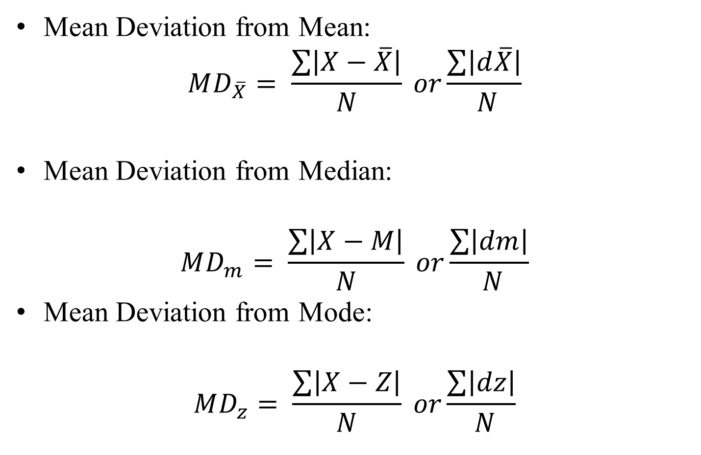
Formula
Mean Deviation from Mean:
$$MD_{\overline{X}}= \frac{\sum{\left|X−\overline{X}\right|}}{N} or\frac{\sum{\left|d\overline{X}\right|}}{ N}$$
Mean Deviation from Median:
$$MD_{m}= \frac{\sum{\left|X−M\right|}}{N} or\frac{\sum{\left|dm\right|}}{ N}$$
Mean Deviation from Mode:
$$MD_{z}= \frac{\sum{\left|X−Z\right|}}{N} or\frac{\sum{\left|dz\right|}}{ N}$$

Slide 13
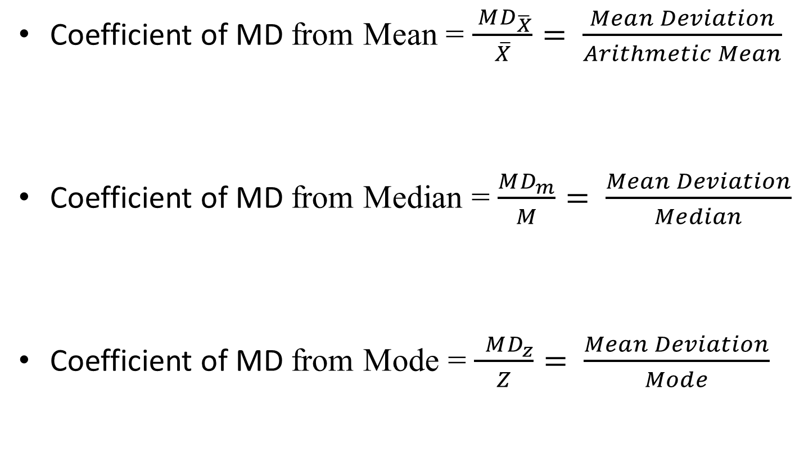
Coefficient of Mean Deviation
Coefficient of MD from Mean = $\frac{ MD_{\overline{X}}}{\overline{X}}= \frac{Mean Deviation}{Arithmetic Mean}$
Coefficient of MD from Median = $\frac{MD_{m}}{M}= \frac{Mean Deviation}{Median}$
Coefficient of MD from Mode = $\frac{ MD_{z}}{Z}= \frac{Mean Deviation}{Mode}$

Slide 14
Merits and Demerits of Mean Deviation
Merits
Simple
Based on all values
Less Effect of Extreme Values
Demerits
Inaccuracy
Not Capable of Algebraic Treatment
Unreliable

Slide 15
Standard Deviation
Standard deviation is a most satisfactory scientific method of dispersion. Accordingly, it is widely used method in statistical analysis.
According to Karl Pearson, “Standard Deviation is the square root of the arithmetic mean of the squares deviations of the items from their mean value.”
Deviations being measured from arithmetic mean of the items.

Slide 16
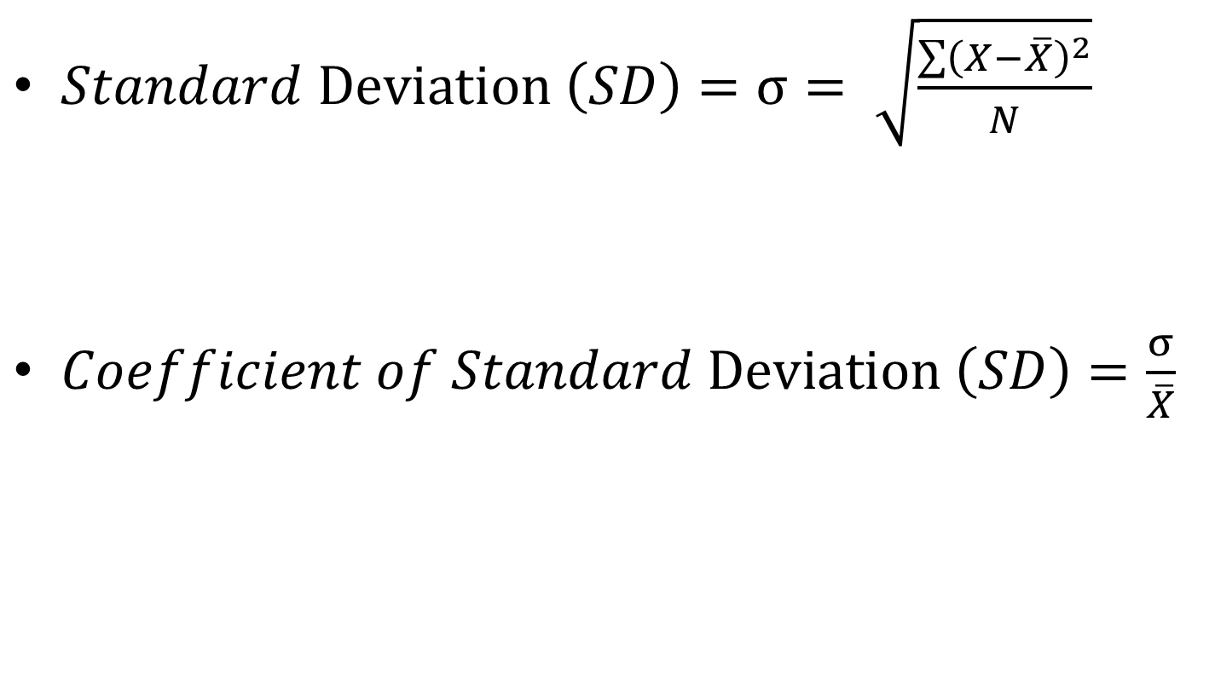
$Standard Deviation \left(SD\right)=σ= \sqrt{\frac{\sum{{\left(X−\overline{X}\right)}^{2}}}{N}}$
$Coefficient of Standard Deviation \left(SD\right)=\frac{σ}{\overline{X}}$

Slide 17
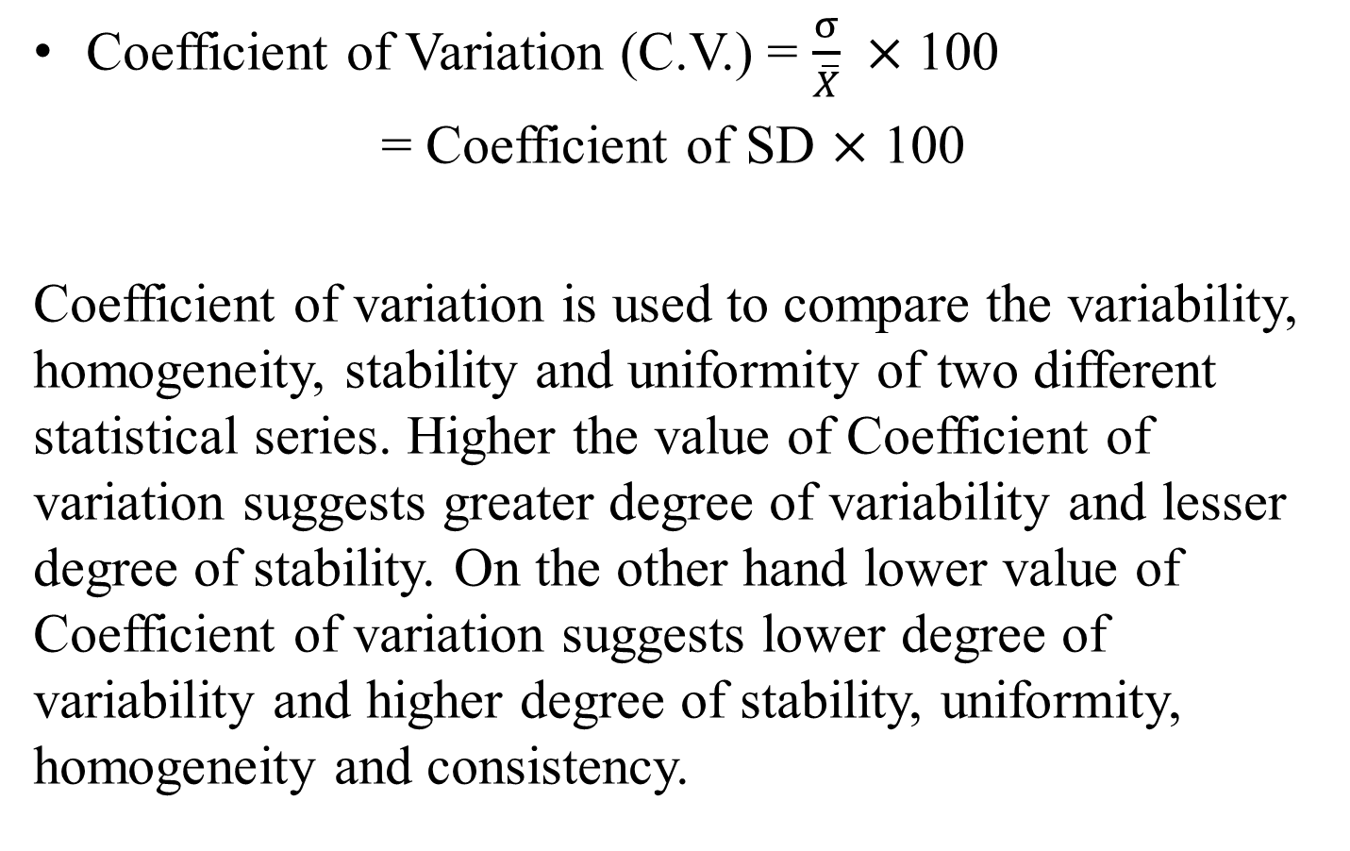
Coefficient of Variation (C.V.)
Coefficient of Variation (C.V.) = $\frac{σ}{\overline{X}} ×$ 100
= Coefficient of SD $×$ 100
Coefficient of variation is used to compare the variability, homogeneity, stability and uniformity of two different statistical series. Higher the value of Coefficient of variation suggests greater degree of variability and lesser degree of stability. On the other hand lower value of Coefficient of variation suggests lower degree of variability and higher degree of stability, uniformity, homogeneity and consistency.

Slide 18
Measure of Skewness
Skewness is an indicator of lack of symmetry in a data. There are two types of skewness:
Symmetric
Asymmetric – (a) Positively skewed
(b) Negatively skewed
Positive Skewness means when the tail on the right side of the distribution is longer or fatter. The mean and median will be greater than the mode.
Negative Skewness is when the tail of the left side of the distribution is longer or fatter than the tail on the right side. The mean and median will be less than the mode.

Slide 19
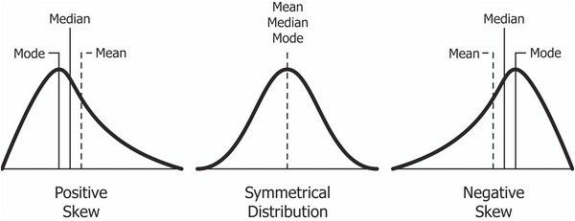

Slide 20
Merits and Demerits of Range
Merits
Simple
Widely used
Demerits
Unstable
Not Based on all values
No knowledge of the formation of the series
Irrelevant for Open-ended frequency Distribution

Slide 21
Bowley’s Coefficient of Skewness = Q₃ + Q₁ -2Q₂
Q₃ - Q₁
_{It varies from -1 to +1.}
If measure is > 0, then it is positively skewed.
If measure is < 0, then it is negatively skewed.
Karl Pearson’s Measure of Skewness = Mean – Mode
_{S. D.}
If calculation of mode is difficult, it can be calculated as
₌ 3(Mean – Median)
S. D.

Slide 22
Kurtosis
Kurtosis refers to the degree of flatness or peakedness in the region about the mode of a frequency curve. The degree of kurtosis of a distribution is measured relative to the peakedness of normal curve. If the curve is more peaked than the normal curve, it is called ‘leptokurtic’. In such a case items are more closely bunched around the mode. On the other hand, If the curve is more flat - topped than the normal curve, it is called ‘platykurtic’. the normal curve itself is called ‘mesokurtic’.

Slide 23
